Slide 1
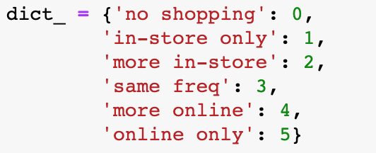
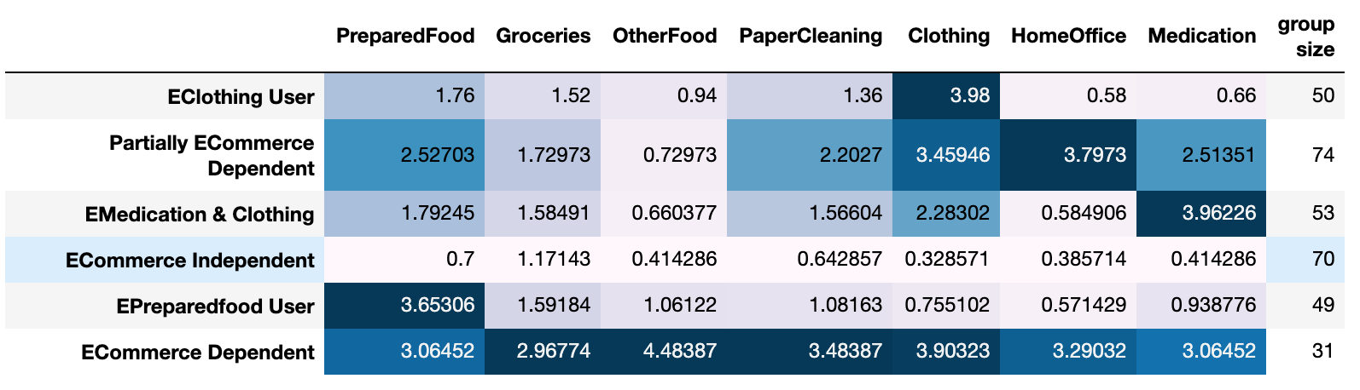
K-Means Considering Level of Online Shopping Dependency
Map Level of online shopping dependency as ordered categorical variable
Use K-Means Clustering with Elbow method
6 groups are identified:

Slide 2
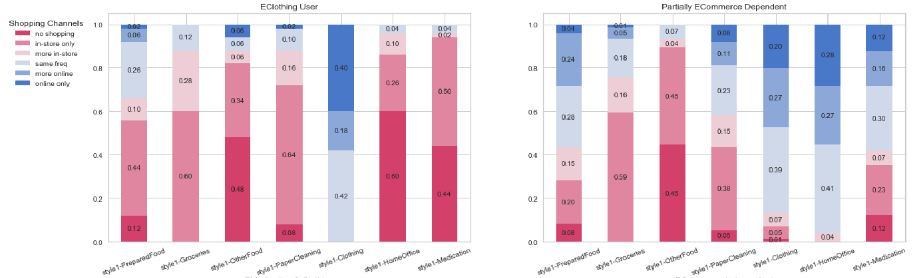
Shopping Channel for different group: Will they purchase? And if yes, through what channel?
Notes:
40% of Eclothing user purchase clothes online & instore at the same frequency. About 10% of people in this group shopped with a higher frequency online than in-store. And 40% of them only shopped clothes online.
For partially Ecommerce dependent users, 96% purchase home office supplies online at a frequency greater or equal to in-store shopping frequency, that for clothing is 87%, for medication is 58% and for preparedfood is 56%.

Slide 3
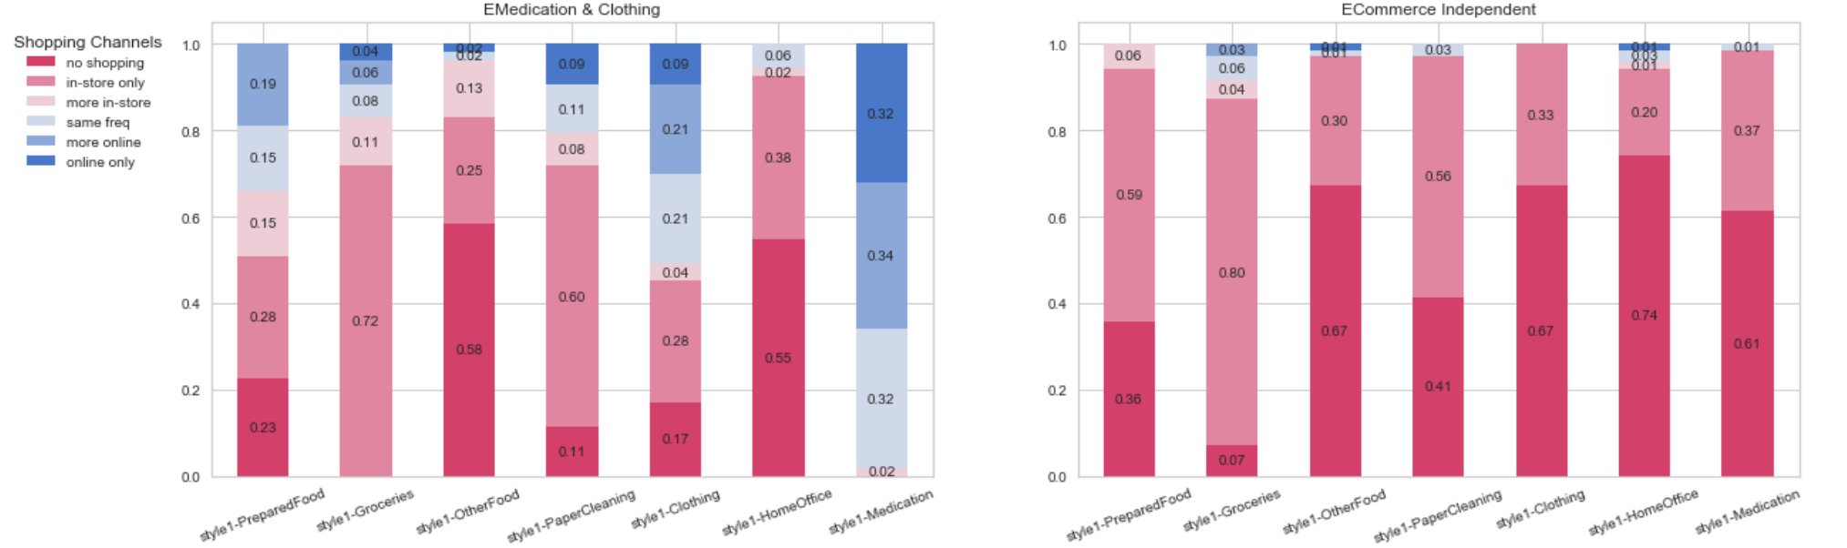
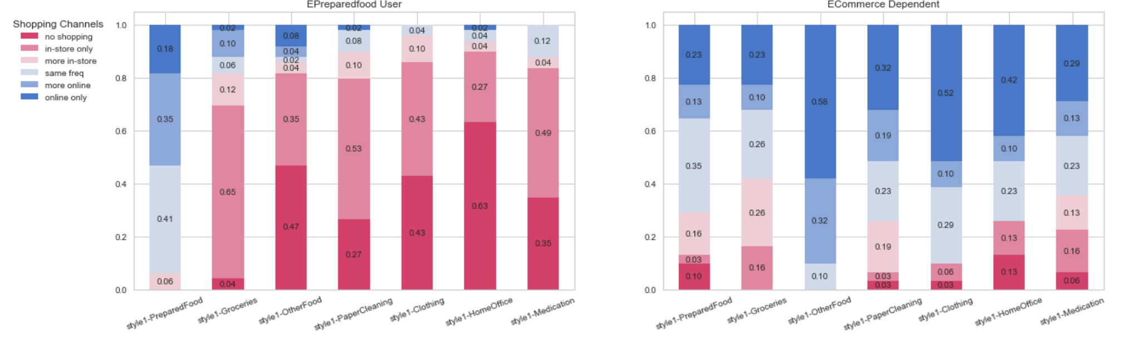
Notes:
For Emedication & Clothing Users, 98% of them purchase medication online at a frequency greater or equal to online shopping. That for clothing is 51%.
Ecommerce independent user is a group of people who very likely did no shopping and if they did, usually purchased in-store only.
94% EpreparedFood User ordered restaurant food at a frequency greater or equal to in-store shopping.
For Ecommerce dependent group, for all categories, more than half of the people purchases products online at a frequency greater or equal to in-store shopping.

Slide 4
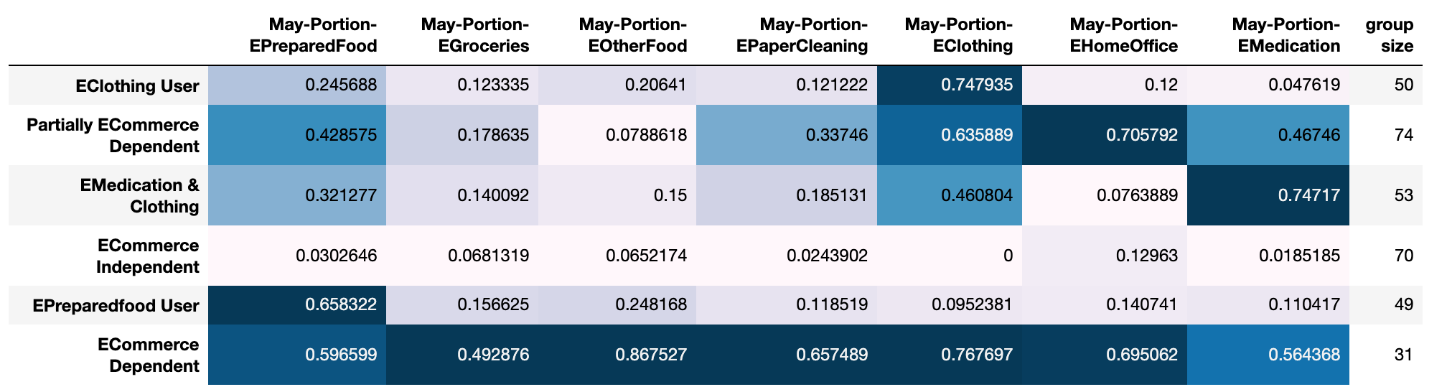
If Purchased, by how much would it be through online channels?
Portion = # of online shopping orders / total shopping events

Slide 5
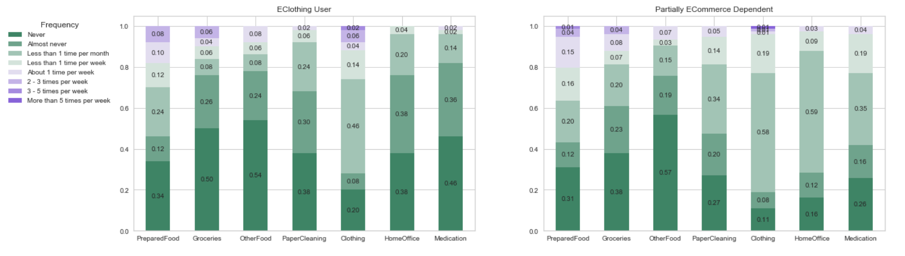
Online shopping behaviors for each group of customers during past year (Jan/Feb 2019-2020)
Notes:
ECommerce Dependent User is the most likely to have already been exposed to online shopping for various category of products. As we can see, for ECommerce dependent group, the portion of customers who never did shopping for certain category of products through online channel in the past year is usually the lowest among all six shopping style groups. While in the contrast, ECommerce independent users is more likely to have never been exposed to online shopping in the past across all category of products. EMedication and clothing user is also a group of people who are less familiar with online shopping, see from the relative higher portion of people without online shopping experience for food and also paper cleaning. However, this group of people is more likely to have experience with online medication purchase compared to the other groups. EPreparedfood Users were more likely to order restaurant food online on a weekly basis with the largest portion of people indicating having online restaurant food ordered with a frequency about 1 time per week or higher in the past year.

Slide 6
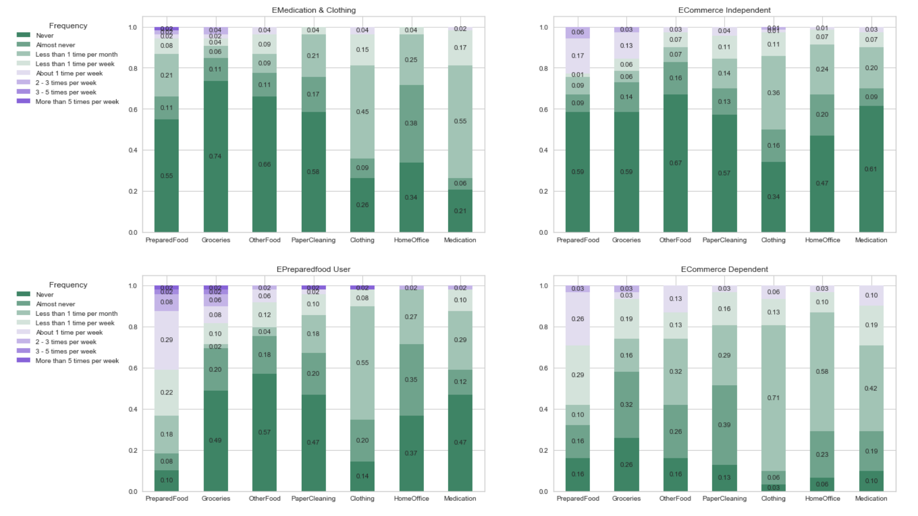

Slide 7
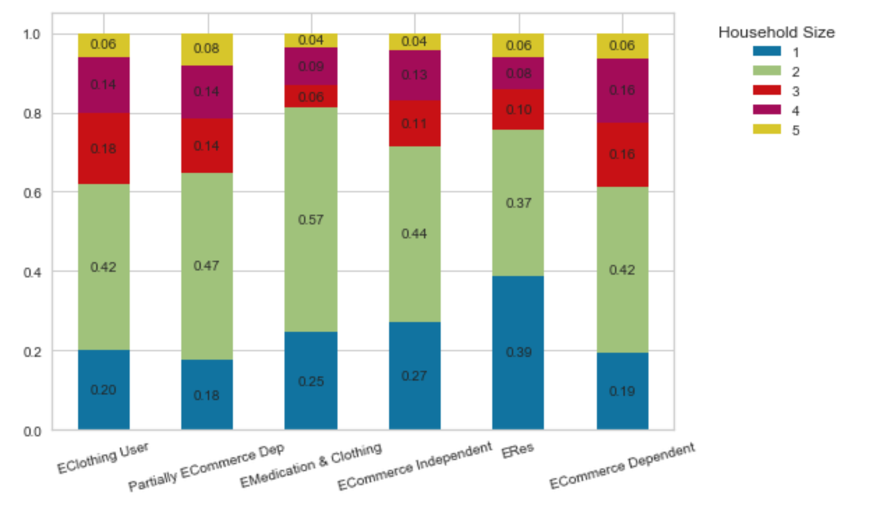
Household Size for Different Group
Epreparedfood User is the group with the highest percentage of single household

Slide 8
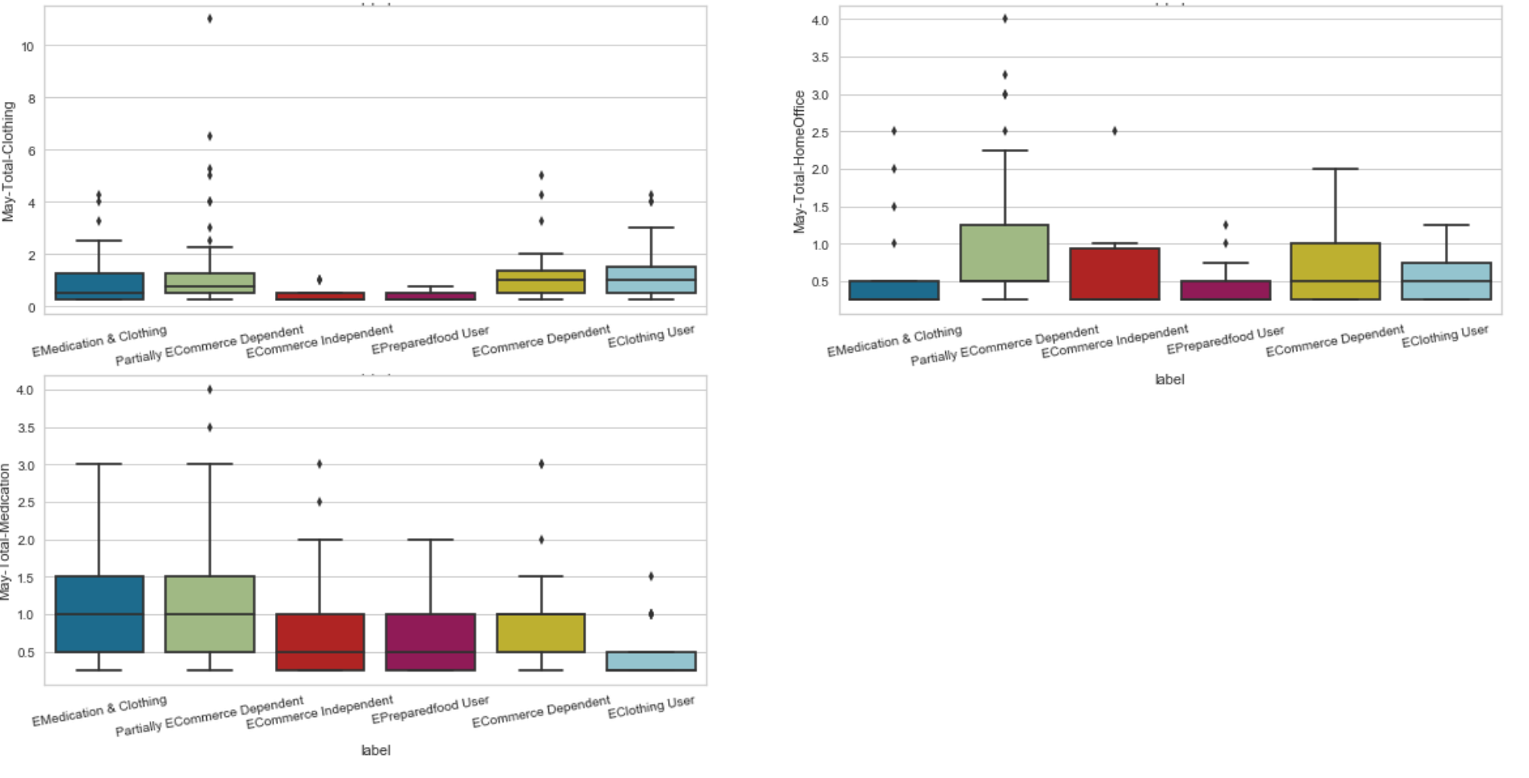
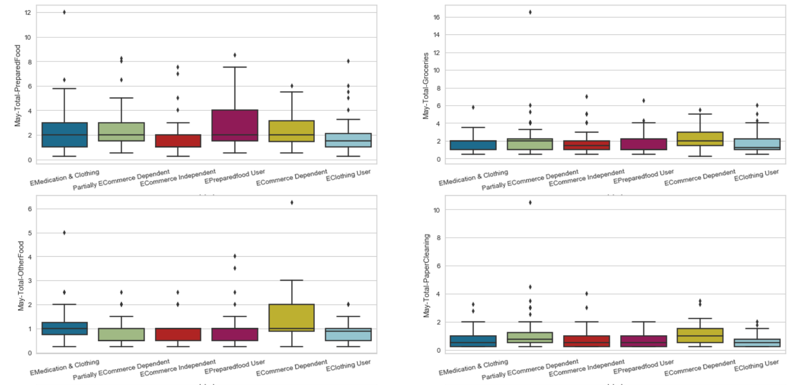
Total Purchase Events (Exclude no shopping)
Notes:
In terms of total shopping events, Ecommerce dependent group usually have more shopping events (Homeoffice, groceries, Otherfood, Paper cleaning) than the others. Eclothing user had the most clothing shopping events, Epreparedfood users had the most restaurant shopping events and EMedication Users had the most medication purchase events.
People who have higher purchase demand are more likely to shop online

Slide 9
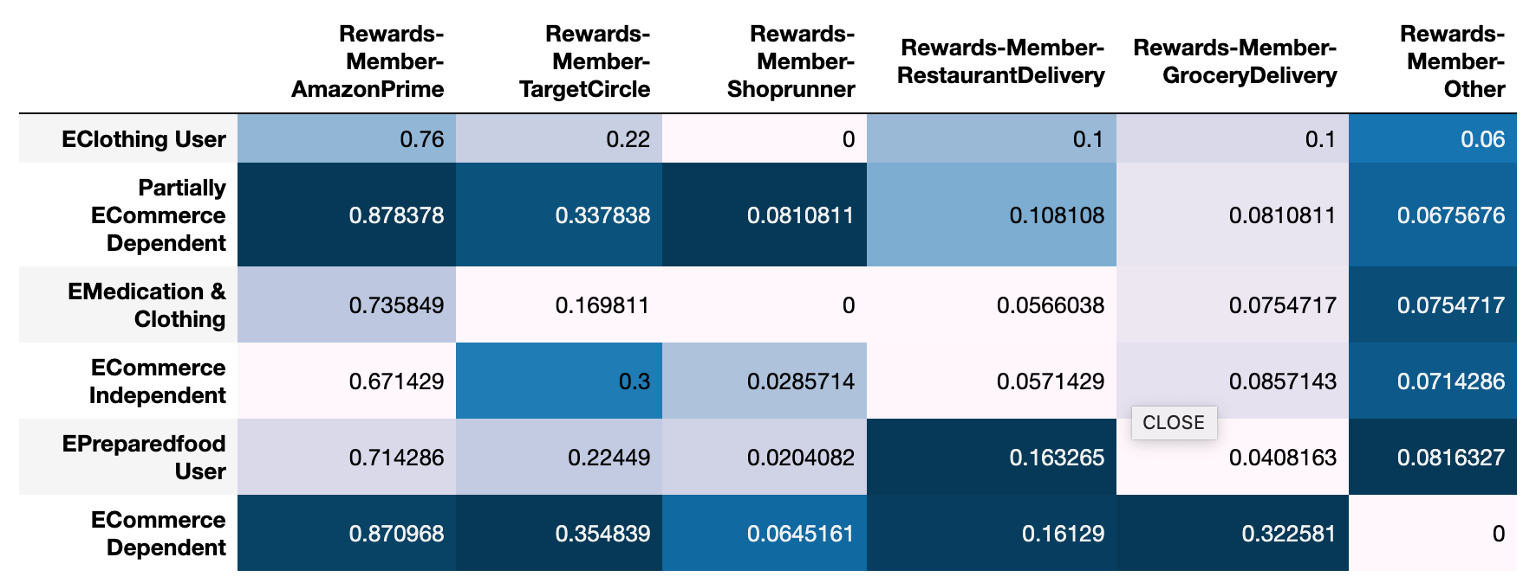
Rewards Membership
Notes:
ECommerce Dependent group has the highest scbscription rate of (TargetCircle (35.5%) and) Grocery delivery (32.2%) service, second highest rate of AmazonPrime (87.1%) while partially ECommece dependent group has the highest AmazonPrime subscription rate (87.8%) and second highest TargetCircle subscription rate (33.8%). In terms of membership of restaurant delivery, EpreparedFood user has the highest subscription rate (16.3%). Ecommerce Independent group had the lowest signup rate of amazon prime membership
Interestingly, compared to other group, ECommerce independent group has the third highest subscription rate of Target Circle. Since Target Circle is more of a membership for in-store shopping, it makes sense for this group to have a relatively high sign-up ratio.

Slide 10
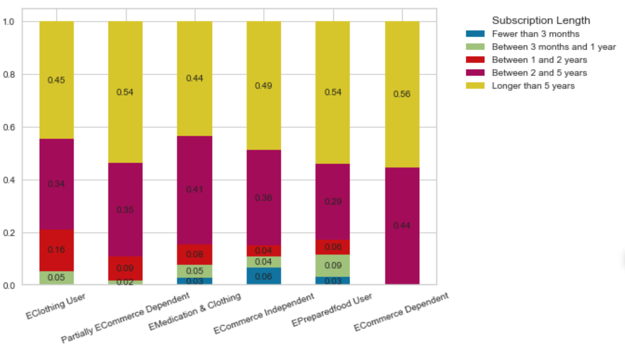
Amazon Prime Subscription Length
Notes:
In terms of subscription length, all from ECommerce Dependent group who subscribes AmazonPrime have been in the membership for more than 2 years. The average of subscription length for partially ECommerce dependent group ranked the second. ECommerce independent group has the highest portion of household with a subscription length fewer than 3 months.

Slide 11
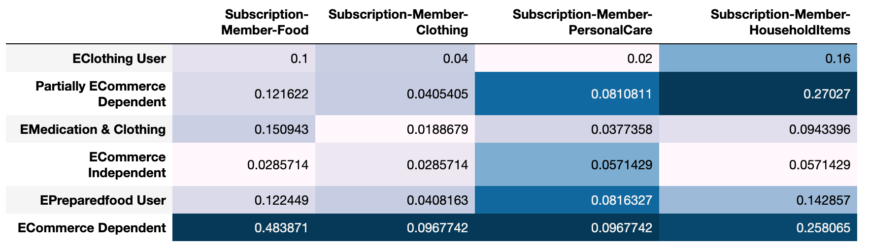
Subscription

Slide 12
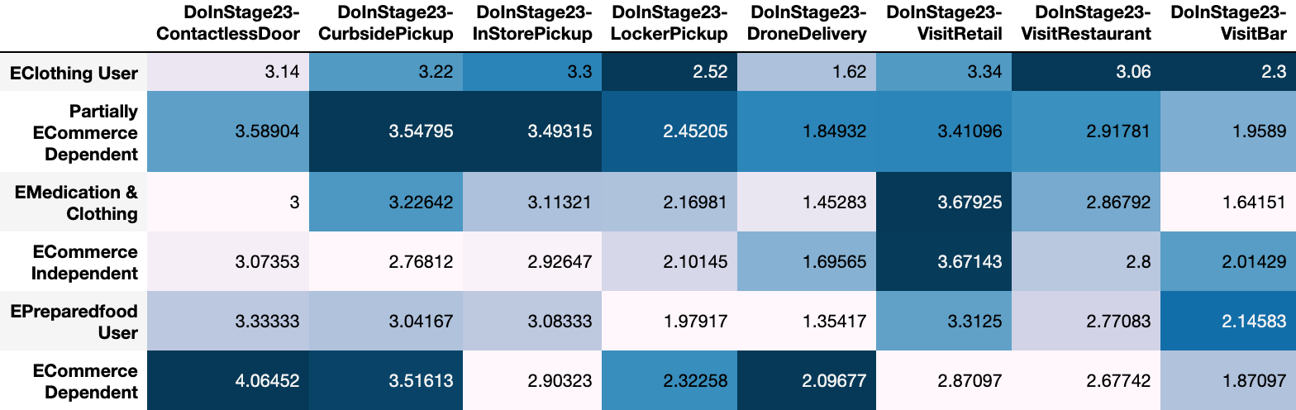
Intention to Do in Stage23
Notes:
ECommerce dependent group has the least intention to conduct in-store activities compared to the other groups. (InStore pickup, visit retail, visit restaurant, visit bar). However, in terms of but most willing to receive packages through contactless door delivery, do curbside pickup. Partially ECommerce dependent group was also willing to reveice package through contactless door delivery, most likely to do curbside pickup. And in constrast to ECommerce dependent group, they are willing to conduct inStore pickup.

Slide 13
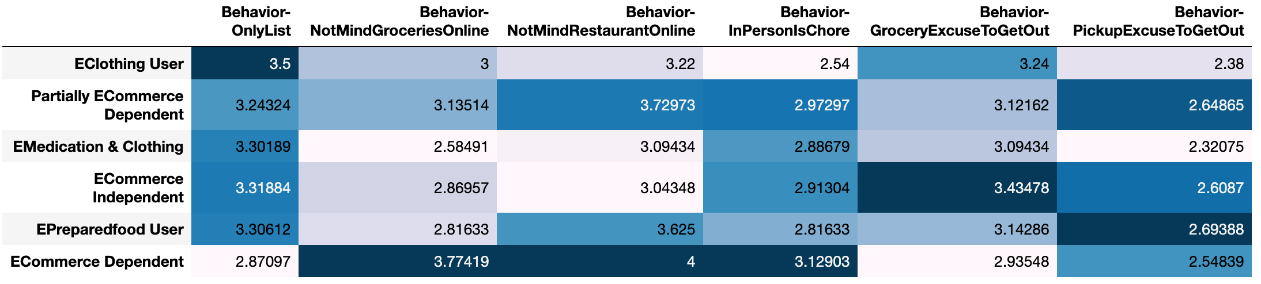
Food Shopping Behaviors
Notes:
Ecommerce dependent users had the most positive attitudes towards online grocery and online restaurant orders. They enjoyed online food shopping, thought in-person shopping is too troublesome for them. They are a group of people who like to stay at home and wouldn’t take grocery or online order pickup as an excuse to get out. What’s more, they are also a group of people who are more likely to purchase at will rather than according to plans. Wheras the Ecommerce independent user likes to get out, usually uses grocery shopping as an excuse. Similarly, Epreparedfood users were more likely to view pickup as an excuse to get out.

Slide 14
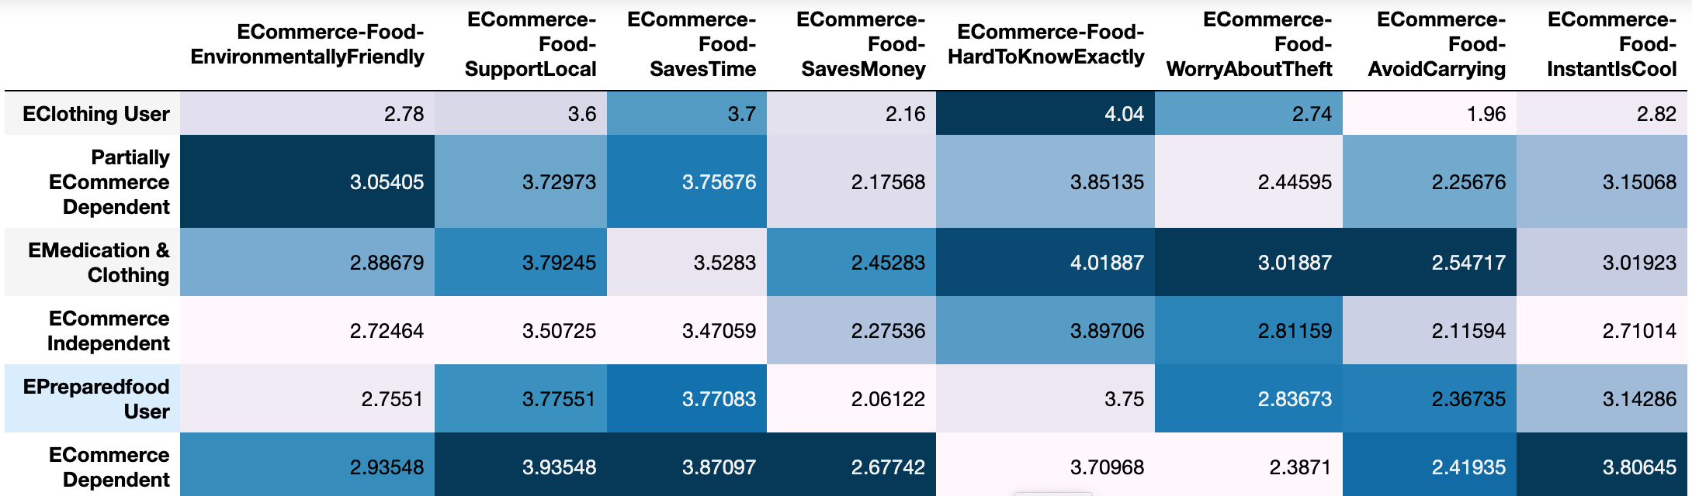
Attitudes Towards Online Grocery & Restaurant
Notes:
Time saving and instant characteristics of online grocery and restaurant are appealing to Ecommerce dependent users. They also thought online order of food can help support local business. Different from Ecommerce dependent user, however, Eclothing and Emedication users, though penetrated by a specific category of online shopping, did not really like online food ordering because they would like to know what they will get. Emedication Users were also worried about orders being stolen.
Overall, the attributes of Efood like local supporting and time saving are recognized by all groups, while the inconsistency of what consumers expect and what they got was also aware by all the groups

Slide 15
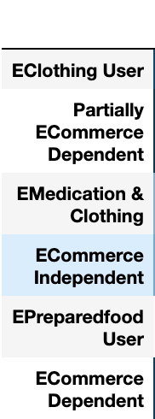
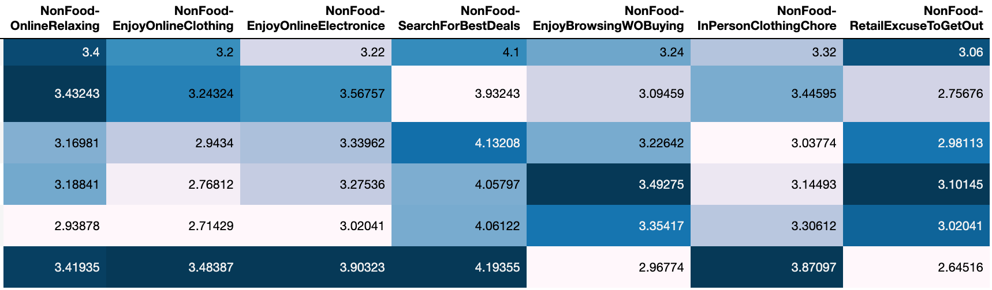
Non-Food Shopping Behaviors
Notes:
Ecommerce dependent users enjoys online shopping very much. They not only view it as a way to relax but also compare between sites and search for the best deals. They really don’t like going out as they enjoy online clothing but view in-person clothing as a chore. And they are the least likely to view retail shopping as an excuse to get out. Eclothing users and partially Ecommerce dependent users are also likely to shop online in order to relax themselves. What’s more, they also enjoy online clothing. As (Partially) Ecommerce dependent users are more penetrated by different categories of online shopping, they also enjoyed online electronic shopping more compared to the other groups.
Ecommerce dependent group, in the contrast, indicated that they like to browsing without buying. What’s more, they enjoyed going out more than the other groups, likely to do retail shopping just to get out of the house. Epreraedfood users also enjoyed browsing without buying.

Slide 16
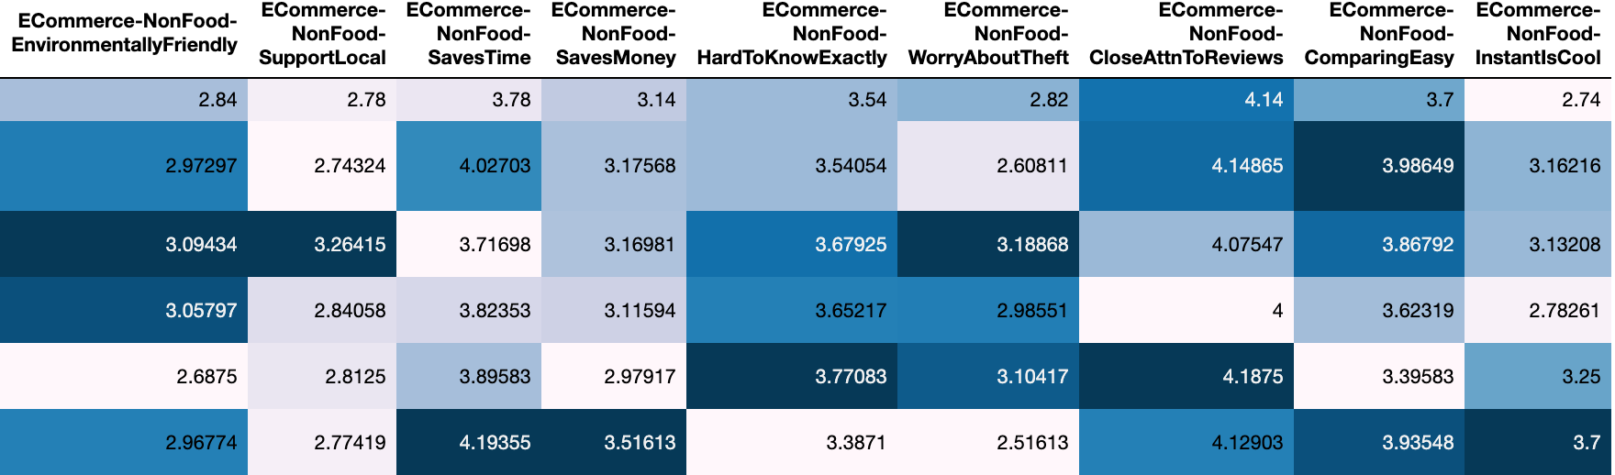
Attitudes Towards Online Non-food Shopping
Notes:
Ecommerce dependent group admire the instant property of non-food online shopping much more compared to the other groups. They also admired the time saving and money saving property of online shopping and like to compare across different sites. The intuition is that this group of household is usually of young age and the income level is not very high. Epreparedfood users felt it hard to guarantee what they would receive will match their expectation. They are relative cautious towards nonfood online shopping and like to pay close attention to the reviews. The cautiousness could be the reason that they enjoy only browsing without purchasing.

